Slide 1
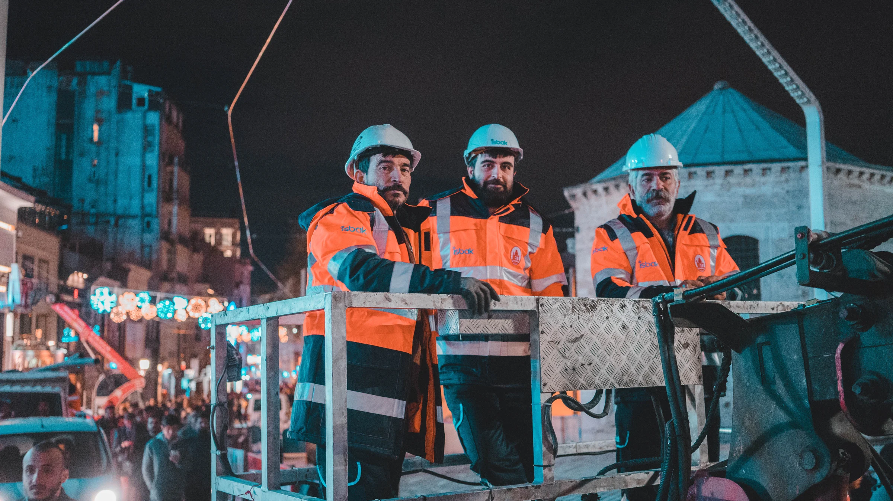
ONGUARD SAFETY DETECTOR

Slide 2
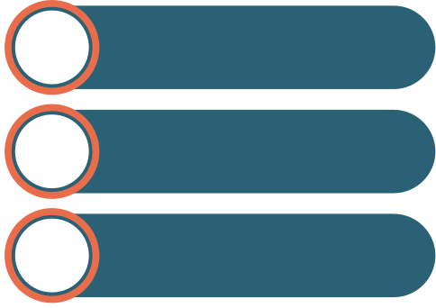
OBJECTIVE
To design and implement an advanced computer vision-based detection system that leverages YOLOv8 models to automatically assess the safety compliance of individuals in images and videos.
The system detects whether a person is wearing essential protective equipment, such as helmets and vests, and classifies their safety status into three categories: "safe" (wearing both), "partially safe" (wearing either), or "not safe" (wearing neither).
This solution is intended to provide real-time, scalable safety monitoring in hazardous environments, improving workplace safety and reducing the risk of accidents through accurate detection and timely alerts.

Slide 3
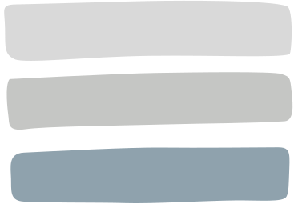
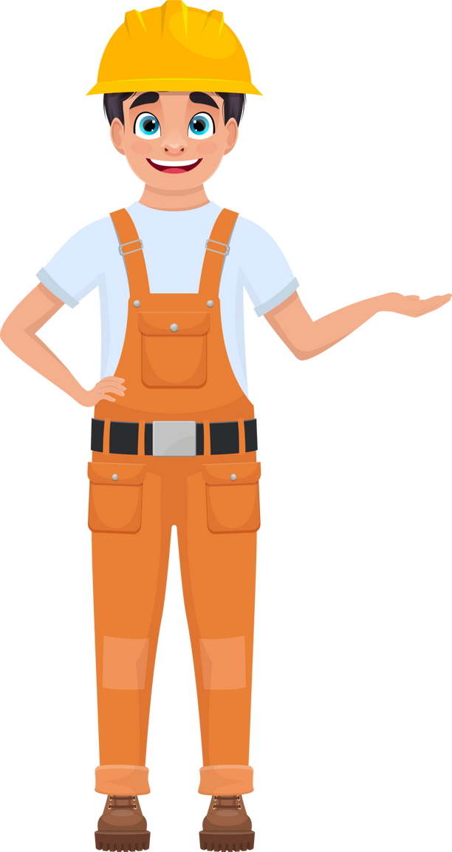
DATASET,SPLIT AND PREPROCESSING
Dataset Overview
Total Images: 3002
Classes:Helmet,Vest(YOLOv8s) Person (YOLOv8n)
Dataset split
Training set: 78% of total data, 2346 images
Validation set: 13% of total data, 385 images
Test set: 9% of total data, 271 images
Dataset preprocessing
Auto-Orient: Applied to ensure images are correctly aligned based on their EXIF data
Resize: Images were resized to 640x640 pixels using a stretch technique to fit the input size requirements for the YOLOv8 model.

Slide 4
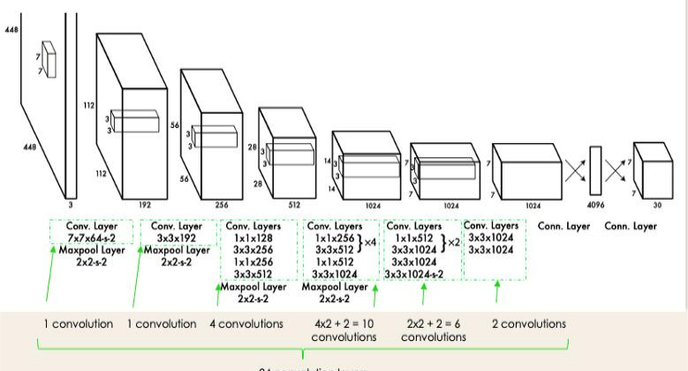
YOLO MODEL ARCHITECTURE

Slide 5
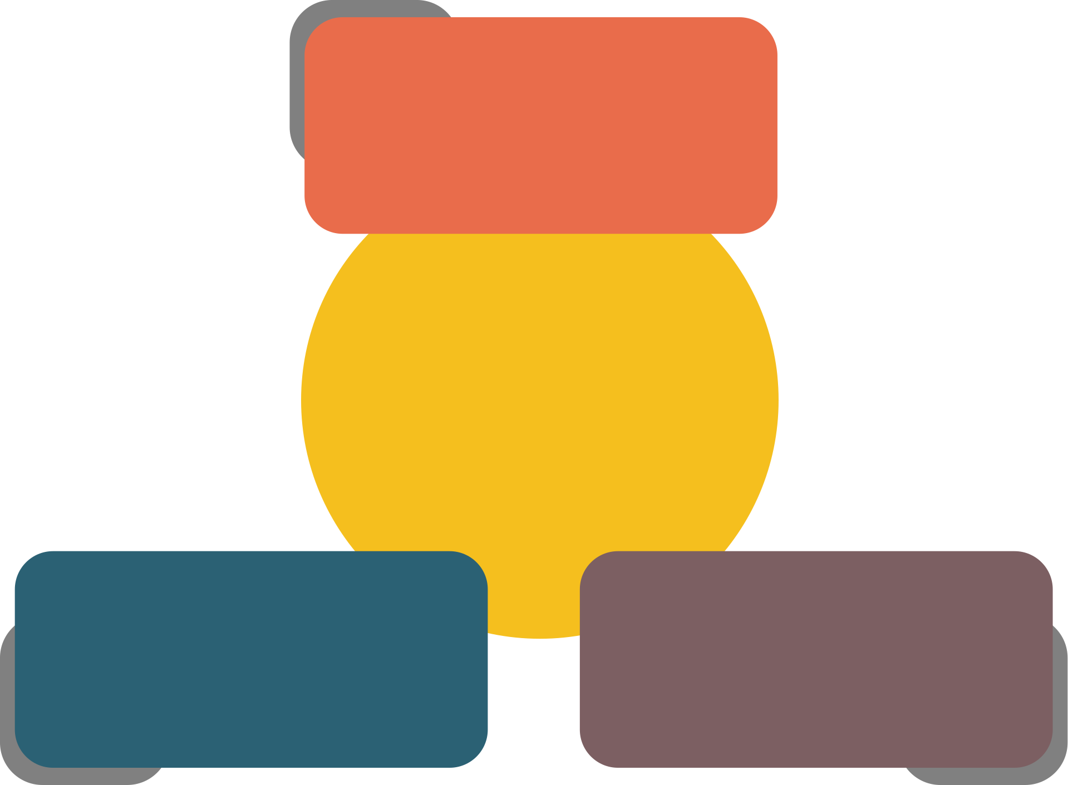


Mean Average
Precision (mAP):
0.95147
MODEL
PERFORMANCE
Recall:
0.88215
Precision:
0.93631

Slide 6
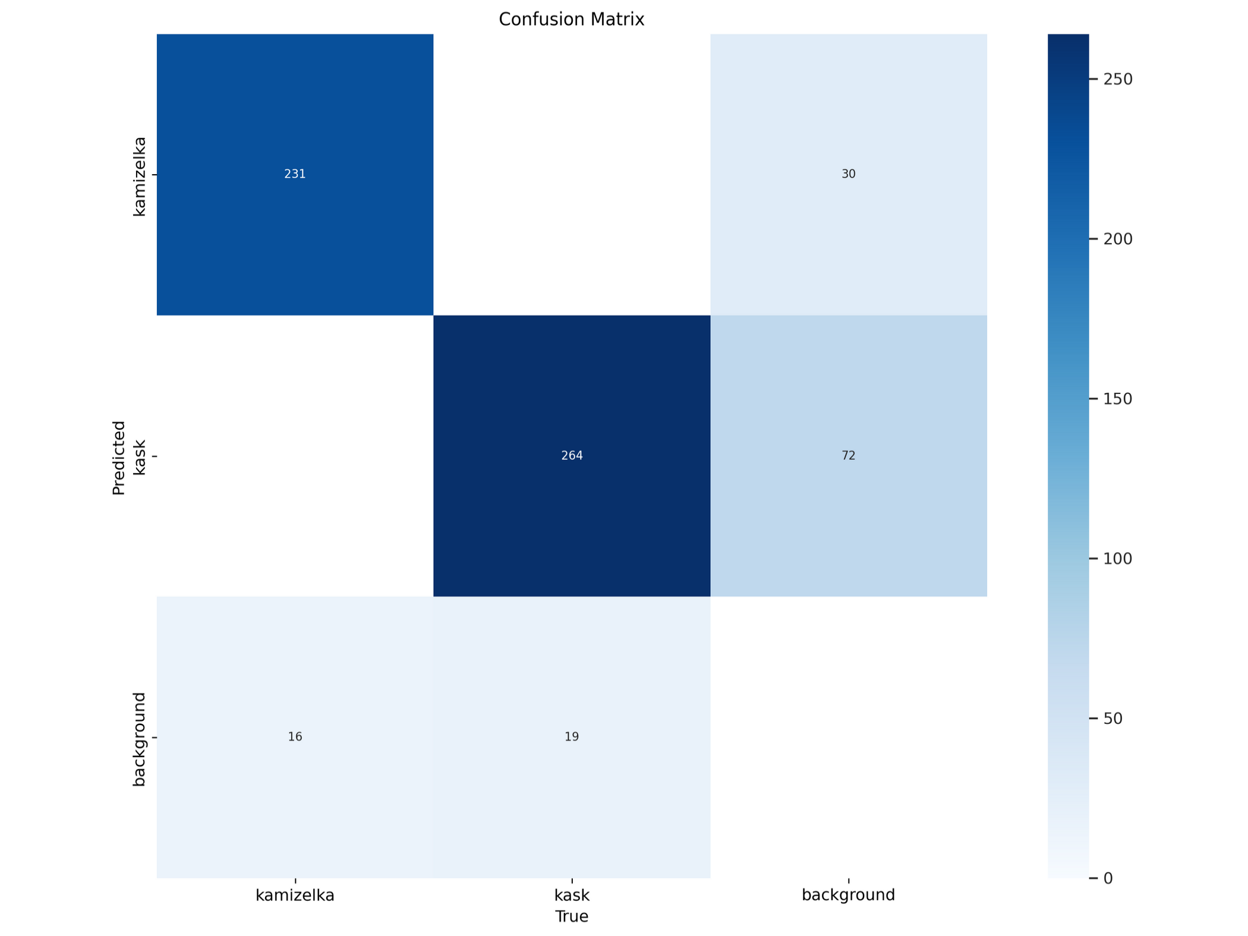

Slide 7
THANK YOU

